Slide 2
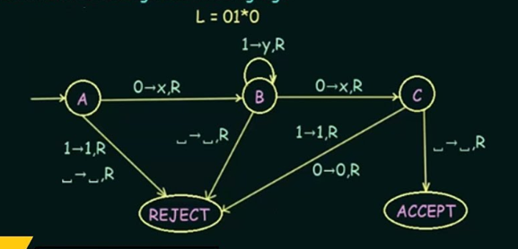
Turing Machine for 01*0

Slide 3





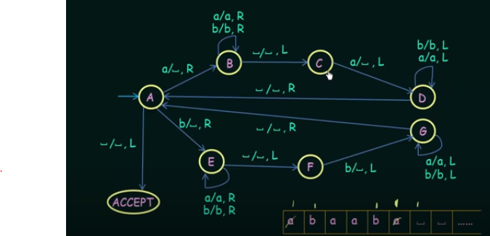
Turing Machine for even length palindromes

Slide 4

Turing Machine for even length palindromes

Slide 5

Turing Machine for even length palindromes

Slide 6

Turing Machine for even length palindromes

Slide 7

Turing Machine for even length palindromes

Slide 8

Turing Machine for even length palindromes

Slide 9

Turing Machine for even length palindromes

Slide 10

Turing Machine for even length palindromes

Slide 11

Turing Machine for even length palindromes

Slide 12

Turing Machine for even length palindromes

Slide 13

Turing Machine for even length palindromes

Slide 14

Turing Machine for even length palindromes

Slide 15

Turing Machine for even length palindromes

Slide 16

Turing Machine for even length palindromes

Slide 17

Turing Machine for even length palindromes

Slide 18

Turing Machine for even length palindromes

Slide 19
Observation:
If we modify the
machine for the language
we can easily construct
a machine for the language

Slide 20
Activity Time
Write basic idea of TM for {v.v: v Є {a,b}*}

Slide 21
Turing Machine:
Input
alphabet
Tape
alphabet
States
Transition
function
Final
states
Initial
state
blank

Slide 22
Turing Machine:

Slide 23
Transition Function

Slide 24
Transition Function

Slide 25
Configuration
Instantaneous description:

Slide 26
Time 4
Time 5
A Move:

Slide 27
Time 4
Time 5
Time 6
Time 7
A computation

Slide 28
Equivalent notation:

Slide 29
Initial configuration:
Input string

Slide 30
The Accepted Language
For any Turing Machine
Initial state
Final state

Slide 31
If a language is accepted
by a Turing machine
then we say that is:
Turing Recognizable
Other names used:
Turing Acceptable
Recursively Enumerable

Slide 32
Standard Turing Machine
The machine we described is the standard:
Deterministic
Infinite tape in both directions
Tape is the input/output file

